Slide 1


Title And Team Introduction
Title: 🌱 AgriTech AI – Smart Farming for Better Harvests
School Name: Shining Stars Nursery and primary school – Vvumba
Presenters: KITONE BENJAMIN,EMOROTO CAROLINE,KEMIREMBE IRENE,LUBEGA ANDREW, NANTONGO JUSTINE.

Slide 2
Problem Statement
The Problem:
Farmers face challenges like crop diseases, pests, unpredictable weather, poor soil quality, and lack of reliable market information.
These challenges lead to low yields, losses and poverty among farming communities in Uganda.
Who is Affected?
Smallholder farmers, farming families and communities that rely on agriculture for income and food security.

Slide 3

Solution & Features
Our Solution – AgriTech AI
An AI-powered platform that helps farmers identify crop diseases, control pests, monitor soil pH, check weather conditions, and improve yields.
Provides a Farmer & Agent Portal for market price updates and product searches.
Demo Video

Slide 4
Process & Use of Technology
Process:
Researched farmer challenges
Designed user-friendly farmer portal and agent portals
Developed backend with JAVASCRIPT, Nodejs, MongoDB + Prisma
Frontend with HTML, CSS, Bootstrap
Tested and deployed on Vercel and Github
Tools & Tech: HTML, Node.js, MongoDB, Prisma, CSS, Github and Vercel deployment.

Slide 5
Impact & Benefits
Benefits:
Provides accurate market price info for better profits
Helps farmers reduce crop loss by detecting diseases early
Improves soil & weather monitoring for higher yields
Encourages digital literacy among farmers
Christian Values Promoted:
Stewardship: Caring for God’s creation (farmland & crops)
Integrity: Honest and transparent market pricing
Service & Compassion: Supporting farmers with solutions that uplift communities
Hope & Love: Empowering farmers with knowledge for a better future

Slide 6
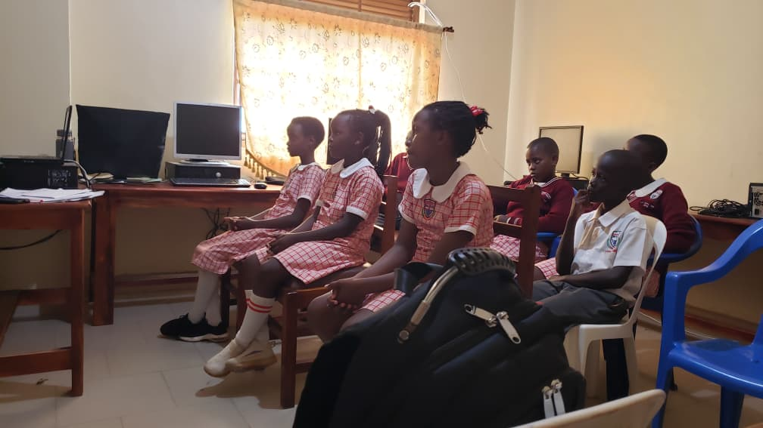
Conclusion & Call to Action
Summary:
AgriTech AI is a smart AI-driven farming assistance that empowers farmers with knowledge, tools and market access.
Call to Action
“Join us in transforming agriculture with technology – together we can feed the future!”
Project link: https://club-shin.vercel.app
Project Source codes: https://github.com/francislub/clubShin

